Slide 1
Data Integration and Large Scale Analysis 12 Distributed ML Systems
Last update: Jan 27, 2023

Slide 2
Agenda
Landscape of ML Systems
Distributed Parameter Servers
Q&A and Exam Preparation

Slide 3
Landscape of ML Systems

Slide 4
What is an ML System?
Landscape of ML Systems
Classification
Regression
Recommenders
Clustering
Dim Reduction
Neural Networks
Statistics
Data Mining
Machine Learning (ML)
ML Applications (entire KDD/DS lifecycle)
Rapidly Evolving
Runtime Techniques (Execution, Data Access)
ML System
Compilation Techniques
Distributed Systems
HPC
Data Management
Accelerators
Operating Systems
Prog. Language Compilers
HW Architecture

Slide 5


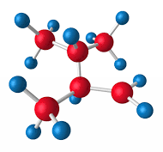

The Data Science Lifecycle aka KDD Process aka CRISP-DM
Landscape of ML Systems
Data-centric View:
Application perspective
Workload perspective System perspective
Data Scientist
Data Integration Data Cleaning Data Preparation
Model Selection Training Hyper-parameters
Validate & Debug Deployment Scoring & Feedback
Exploratory Process (experimentation, refinements, ML pipelines)
Data/SW Engineer
ML/DevOps Engineer

Slide 6
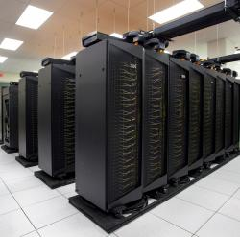
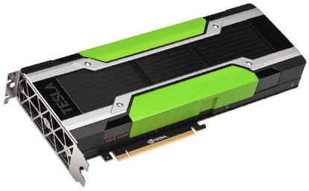
Driving Factors for ML
Landscape of ML Systems
[Credit: Andrew Ng’14]
Improved Algorithms and Models
Success across data and application domains (e.g., health care, finance, transport, production)
More complex models which leverage large data
Availability of Large Data Collections
Increasing automation and monitoring ➔ data (simplified by cloud computing & services)
Feedback loops, data programming/augmentation
HW & SW Advancements
Higher performance of hardware and infrastructure (cloud)
Open-source large-scale computation frameworks, ML systems, and vendor-provides libraries
Feedback Loop
Data
Usage
Model

Slide 7
Stack of ML Systems
Landscape of ML Systems
Deployment & Scoring
Validation & Debugging
Training
Hyper-parameter Tuning
ML Apps & Algorithms
Supervised, unsupervised, RL
linear algebra, libs, AutoML
Model and Feature Selection
Language Abstractions
Eager interpretation, lazy evaluation, prog. compilation
Data Programming & Augmentation
Fault Tolerance
Approximation, lineage, checkpointing, checksums, ECC
Execution Strategies
Local, distributed, cloud (data, task, parameter server)
Data Preparation (e.g., one-hot, binning)
Data Representations
Dense & sparse tensor/matrix;
compress, partition, cache
Data Integration & Data Cleaning
CPUs, NUMA, GPUs, FPGAs, ASICs, RDMA, SSD/NVM
HW & Infrastructure
Improve accuracy vs. performance vs. resource requirements
➔ Specialization & Heterogeneity

Slide 8
Accelerators (GPUs, FPGAs, ASICs)
Landscape of ML Systems
Apps
Lang
Faults
Memory- vs Compute-intensive
CPU: dense/sparse, large mem, high mem-bandwidth, moderate compute
GPU: dense, small mem, slow PCI, very high mem-bandwidth / compute
Graphics Processing Units (GPUs)
Extensively used for deep learning training and scoring
NVIDIA Volta: “tensor cores” for 4x4 mm → 64 2B FMA instruction
Field-Programmable Gate Arrays (FPGAs)
Customizable HW accelerators for prefiltering, compression, DL
Examples: Microsoft Catapult/Brainwave Neural Processing Units (NPUs)
Application-Specific Integrated Circuits (ASIC)
Spectrum of chips: DL accelerators to computer vision
Examples: Google TPUs (64K 1B FMA), NVIDIA DLA, Intel NNP
DL
Exec
Data
Ops
Roofline Analysis
HW
ML
Operational Intensity

Slide 9
Data Representation
Landscape of ML Systems
Apps
Lang
Faults
ML- vs DL-centric Systems
ML: dense and sparse matrices or tensors, different sparse formats (CSR, CSC, COO), frames (heterogeneous)
DL: mostly dense tensors, embeddings for NLP, graphs
Data-Parallel Operations for ML
Distributed matrices: RDD<MatrixIndexes,MatrixBlock>
Data properties: distributed caching, partitioning, compression
Lossy Compression ➔ Acc/Perf-Tradeoff
Sparsification (reduce non-zero values)
Quantization (reduce value domain), learned
New data types: Intel Flexpoint (mantissa, exp)
Exec
Data
HW
vec(Berlin) – vec(Germany) + vec(France) ≈ vec(Paris)
Node1
Node2
[Credit: Song Han’16]

Slide 10



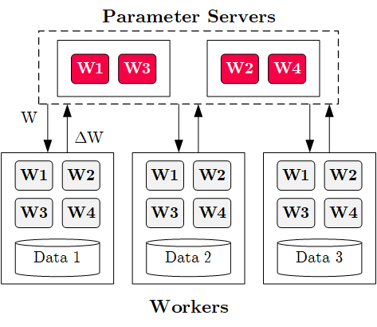




Execution Strategies
Landscape of ML Systems
Apps
Lang
Faults
Batch Algorithms: Data and Task Parallel
Data-parallel operations
Different physical operators
Mini-Batch Algorithms: Parameter Server
Data-parallel and model-parallel PS
Update strategies (e.g., async, sync, backup)
Data partitioning strategies
Federated ML (trend 2018)
Lots of PS Decisions ➔ Acc/Perf-Tradeoff
Configurations (#workers, batch size/param schedules, update type/freq)
Transfer optimizations: lossy compression, sparsification, residual accumulation, layer-wise all-reduce, gradient clipping, momentum corrections
Exec
Data
HW

Slide 11
Fault Tolerance & Resilience
Landscape of ML Systems
Apps
Lang
Faults
Resilience Problem
Increasing error rates at scale (soft/hard mem/disk/net errors)
Robustness for preemption
Need cost-effective resilience
Fault Tolerance in Large-Scale Computation
Block replication (min=1, max=3) in distributed file systems
ECC; checksums for blocks, broadcast, shuffle
Checkpointing (MapReduce: all task outputs; Spark/DL: on request)
Lineage-based recomputation for recovery in Spark
ML-specific Schemes (exploit app characteristics)
Estimate contribution from lost partition to avoid strugglers
Example: user-defined “compensation” functions
Exec
Data
HW

Slide 12


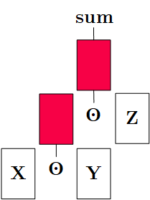
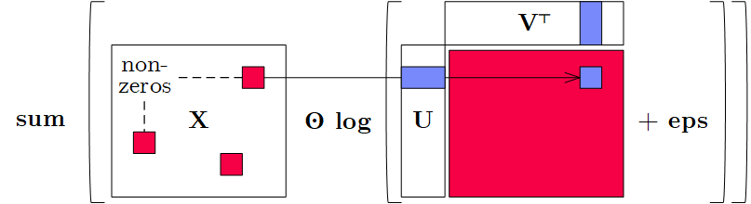
Language Abstractions
Landscape of ML Systems
Apps
Lang
Faults
Optimization Scope
#1 Eager Interpretation (debugging, no opt)
#2 Lazy expression evaluation (some opt, avoid materialization)
#3 Program compilation (full opt, difficult)
Optimization Objective
Most common: min time s.t. memory constraints
Multi-objective: min cost s.t. time, min time s.t. acc, max acc s.t. time
Trend: Fusion and Code Generation
Custom fused operations
Examples: SystemDS, Weld, Taco, Julia, TF XLA, TVM, TensorRT
Exec
Data
HW
Apache SystemDS
Sparsity-Exploiting Operator

Slide 13
ML Applications
Landscape of ML Systems
Apps
Lang
Faults
ML Algorithms (cost/benefit – time vs acc)
Unsupervised/supervised; batch/mini-batch; first/second-order ML
Mini-batch DL: variety of NN architectures and SGD optimizers
Specialized Apps: Video Analytics in NoScope (time vs acc)
Difference detectors / specialized models for “short-circuit evaluation”
AutoML (time vs acc)
Not algorithms but tasks (e.g., doClassify(X, y) + search space)
Examples: MLBase, Auto-WEKA, TuPAQ, Auto-sklearn, Auto-WEKA 2.0
AutoML services at Microsoft Azure, Amazon AWS, Google Cloud
Data Programming and Augmentation (acc?)
Generate noisy labels for pre-training
Exploit expert rules, simulation models, rotations/shifting, and labeling IDEs (Software 2.0)
Exec
Data
HW
[Credit: Daniel Kang‘17]
[Credit: Jonathan Tremblay‘18]

Slide 14





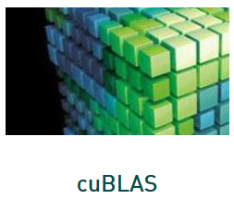
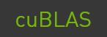


Landscape of ML Systems
Landscape of ML Systems
#1 Language Abstraction
#2 Execution Strategies
Linear Algebra Programs
Parameter Server (Modell-Parallel)
Computation Graphs
Task-Parallel Constructs
Algorithm Libraries
Data-Parallel Operations
Operator Libraries
Collections
Local (single node)
Graphs
Matrices
HW accelerators (GPUs, FPGAs, ASICs)
Tensors
Frames
Distributed
#4 Data Types
#3 Distribution

Slide 15
Distributed Parameter Servers

Slide 16
Background: Mini-batch ML Algorithms
Distributed Parameter Servers
W’
Mini-batch ML Algorithms
Iterative ML algorithms, where each iteration only uses a batch of rows to make the next model update (in epochs or w/ sampling)
For large and highly redundant training sets
Applies to almost all iterative, model-based ML algorithms (LDA, reg., class., factor., DNN)
Stochastic Gradient Descent (SGD)
Statistical vs Hardware Efficiency (batch size)
Statistical efficiency: # accessed data points to achieve certain accuracy
Hardware efficiency: number of independent computations to achieve high hardware utilization (parallelization at different levels)
Beware higher variance / class skew for too small batches!
➔ Training Mini-batch ML algorithms sequentially is hard to scale
Data
Batch 1
Batch 2
W’’
Epoch

Slide 17
Background: Mini-batch DNN Training (LeNet)
Distributed Parameter Servers
[Yann LeCun, Leon Bottou, Yoshua Bengio, and Patrick Haffner: Gradient-Based Learning Applied to Document Recognition, Proc of the IEEE 1998]
# Initialize W1-W4, b1-b4
# Initialize SGD w/ Nesterov momentum optimizer
iters = ceil(N / batch_size)
for( e in 1:epochs ) {
for( i in 1:iters ) {
X_batch = X[((i-1) * batch_size) %% N + 1:min(N, beg + batch_size - 1),]
y_batch = Y[((i-1) * batch_size) %% N + 1:min(N, beg + batch_size - 1),]
## layer 1: conv1 -> relu1 -> pool1
## layer 2: conv2 -> relu2 -> pool2
## layer 3: affine3 -> relu3 -> dropout
## layer 4: affine4 -> softmax
outa4 = affine::forward(outd3, W4, b4)
probs = softmax::forward(outa4)
## layer 4: affine4 <- softmax
douta4 = softmax::backward(dprobs, outa4)
[doutd3, dW4, db4] = affine::backward(douta4, outr3, W4, b4)
## layer 3: affine3 <- relu3 <- dropout
## layer 2: conv2 <- relu2 <- pool2
## layer 1: conv1 <- relu1 <- pool1
# Optimize with SGD w/ Nesterov momentum W1-W4, b1-b4
[W4, vW4] = sgd_nesterov::update(W4, dW4, lr, mu, vW4)
[b4, vb4] = sgd_nesterov::update(b4, db4, lr, mu, vb4)
}
}
NN Forward Pass
NN Backward Pass → Gradients
Model Updates

Slide 18
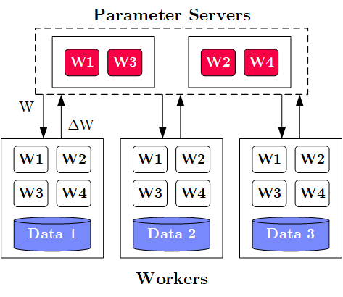
Overview Data-Parallel Parameter Servers
Distributed Parameter Servers
M
System Architecture
M Parameter Servers
N Workers
Optional Coordinator
Key Techniques
Data partitioning D → workers Di (e.g., disjoint, reshuffling)
Updated strategies (e.g., synchronous, asynchronous)
Batch size strategies (small/large batches, hybrid methods)
W .. Model
ΔW .. Gradient
N

Slide 19
History of Parameter Servers
Distributed Parameter Servers
1st Gen: Key/Value
Distributed key-value store for parameter exchange and synchronization
Relatively high overhead
2nd Gen: Classic Parameter Servers
Parameters as dense/sparse matrices
Different update/consistency strategies
Flexible configuration and fault tolerance
3rd Gen: Parameter Servers w/ improved data communication
Prefetching and range-based pull/push
Lossy or lossless compression w/ compensations
Examples
TensorFlow, MXNet, PyTorch, CNTK, Petuum
[Alexander J. Smola, Shravan M. Narayanamurthy: An Architecture for Parallel Topic Models. PVLDB 2010]
[Jeffrey Dean et al.: Large Scale Distributed Deep Networks. NIPS 2012]
[Mu Li et al: Scaling Distributed Machine Learning with the Parameter Server. OSDI 2014]
[Jiawei Jiang, Bin Cui, Ce Zhang, Lele Yu: Heterogeneity-aware Distributed Parameter Servers. SIGMOD 2017]
[Jiawei Jiang et al: SketchML: Accelerating Distributed Machine Learning with Data Sketches. SIGMOD 2018]

Slide 20
Basic Worker Algorithm (batch)
Distributed Parameter Servers
for( i in 1:epochs ) {
for( j in 1:iterations ) {
params = pullModel(); # W1-W4, b1-b4 lr, mu
batch = getNextMiniBatch(data, j);
gradient = computeGradient(batch, params);
pushGradients(gradient); }
}
[Jeffrey Dean et al.: Large Scale Distributed Deep Networks. NIPS 2012]

Slide 21
Extended Worker Algorithm (nfetch batches)
Distributed Parameter Servers
gradientAcc = matrix(0,...);
for( i in 1:epochs ) {
for( j in 1:iterations ) {
if( step mod nfetch = 0 )
params = pullModel();
batch = getNextMiniBatch(data, j);
gradient = computeGradient(batch, params);
gradientAcc += gradient;
params = updateModel(params, gradients);
if( step mod nfetch = 0 ) {
pushGradients(gradientAcc); step = 0; gradientAcc = matrix(0, ...);
}
step++;
} }
nfetch batches require local gradient accrual and local model update
[Jeffrey Dean et al.: Large Scale Distributed Deep Networks. NIPS 2012]

Slide 22
Update Strategies
Distributed Parameter Servers
Bulk Synchronous Parallel (BSP)
Update model w/ accrued gradients
Barrier for N workers
Asynchronous Parallel (ASP)
Update model for each gradient
No barrier
Synchronous w/ Backup Workers
Update model w/ accrued gradients
Barrier for N of N+b workers
Batch 1
Batch 2
Batch 3
Batch 1
Batch 2
Batch 3
Batch 1
Batch 2
Batch 3
Batch 1
Batch 2
Batch 3
Batch 1
Batch 2
Batch 3
but, stale model updates
Batch 1
Batch 2
Batch 3
Batch 1
Batch 2
Batch 3
Batch 1
Batch 2
Batch 3
Batch 1
Batch 2
Batch 3
Batch 1
Batch 2
Batch 3
Batch 1
Batch 2
Batch 3
Batch 1
Batch 2
Batch 3
[Martín Abadi et al: TensorFlow: A System for Large-Scale Machine Learning. OSDI 2016]

Slide 23
Q&A and Exam Preparation
Selected Example Questions

Slide 24
Multiple choice question (40/100)
62/120
Given the dataset identify the type of missingness.
Missing Completely at Random (MCAR)
Missing at Random (MAR)
Missing Not at Random (MNAR)
All of above
Profession | Salary
A | 2000
C | 5000
B | 2300
C | ?
C | ?
A | 2000

Slide 25
Data Warehousing
Q&A and Exam Preparation
Given the following normalized schema, create a Star Schema that covers all information. Annotate the key concepts. [15/100 points]
Parts
PartKey
Name
Brand
Lineitem
OrderKey
PartKey
SuppKey
Quantity
Price
Tax
Order
OrderKey
CustKey
Totalprice
Date
Customer
CustKey
Name
Address
Mktsegmnt
PartSupp
PartKey
SuppKey
Supplier
SuppKey
Name
Address
Parts
PartKey
Name
Brand
Fact Table
Customer
CustKey
Name
Address
Mktsegmnt
Lineitem
CustKey
DateKey
PartKey
SuppKey
Quantity
Price
Tax
Dimension Tables
Supplier
SuppKey
Name
Address
Date
DateKey
Day
Month
Year
Descriptive Attributes
Categorical Attributes
Measures
Notes:
Alternative: OrderKey in Fact Table

Slide 26
Message-oriented Middleware
Q&A and Exam Preparation
Describe the Message Delivery Guarantees At-Most-Once, At-Least-Once and Exactly-Once, and indicate which of them require persistent storage before sending. [6/100 points]
Name | Description | Storage
At-Most-Once | Send and forget, never sent message twice (even on failures) | No
At-Least-Once | Store and forward, replay stream from (acknowledged) checkpoint | Yes
Exactly-Once | Store and forward, replay stream from (acknowledged) checkpoint, transactional delivery | Yes

Slide 27
Schema Matching / Entity Linking
Q&A and Exam Preparation
Explain the phases of a typical Entity Resolution Pipeline with example techniques for the individual phases. [20/100 points]
Prepare Data
Blocking/Sorting
Matching
Clustering
A2
A2
A
r1, r4
A1
C1
D1
A1
A1
A2
B1
B2
C2
C1
C2
C
r2, r7
C1
C2
B3
D1
D1
D
r3
B1
B2
B1
B2
r5, r6, r8
B3
B3
B

Slide 28
Data Parallel Computation / Stream Mining
Q&A and Exam Preparation
Assume three nodes with CPU and memory capacity N1 (32 cores, 64 GB), N2 (16 cores, 64 GB), N3 (64 cores, 128 GB) and a stream of resource requests R1 . . . R7. Schedule these requests to available resources (assign requests to nodes) in order to maximize the number of fulfilled requests. (4 points)
R1: (30 cores, 8 GB)
R2: (6 cores, 32 GB)
R3: (8 cores, 64 GB)
R4: (10 cores, 32 GB)
R5: (8 cores, 32 GB)
R6: (16 cores, 64 GB)
R7: (16 cores, 16 GB)
 | N1 (32/64) | N2 (16/64) | N3 (64/128)
requests | R6 | R2, R4 | R1, R3, R5, R7
utilization | 16/64 | 16/64 | 62/120
Notes:
Note: reduceByKey also possible of course

Slide 29
Stream Processing
Q&A and Exam Preparation
Describe the concept of Continuous Queries and a Basic System Infrastructure to process them over incoming data streams. [8/100 points]
Deployed Data flow graphs
Nodes: asynchronous ops (w/ state) (e.g., separate threads / queues)
Edges: data dependencies (tuple/message streams)
Push model: data production controlled by source
Given the continuous query A-B-C, what are the resulting perf characteristics? [4 points]
Max throughput
Min tuple latency
Archive
State
A
B
C
1ms
5ms
2ms
1/max(C(op_{i})) = 1/5 tuples/ms = 200 tuples/s
sum(C(op_{i})) = 1ms + 5ms + 2ms = 8ms

Slide 30
Stream Processing, cont.
Q&A and Exam Preparation
Describe the three classes of techniques for handling overload situations in continuous queries? [6/100 points]
#1 Back Pressure
Graceful handling of overload w/o data loss
Slow down sources
E.g., blocking queues
#2 Load Shedding
#1 Random-sampling-based load shedding
#2 Relevance-based load shedding
#3 Summary-based load shedding (synopses)
#3 Distributed Stream Processing (see last part)
Data flow partitioning (distribute the query)
Key range partitioning (distribute the data stream
A
B
C
3ms
9ms
2ms
Self-adjusting operator scheduling
Pipeline runs at rate of slowest op

Slide 31
Summary and Q&A
Thanks
(please, participate in the course evaluation)
Landscape of ML Systems
Distributed Parameter Servers
Q&A and Exam Preparation
#2 Course Evaluation and Exam
Evaluation period: Jan 15 – Feb 15 (1/98)
Exam date: Feb 10

